Slide 1
(Brief) Matrix Addition and Multiplication

Slide 2
Introduction
Matrix – a rectangular array of values
Row 0
Row 1
4 5 6
3 7 8 10
This is a 2 x 4 matrix.
Rows
Columns
Column 0
Column 1
Column 2
Column 3

Slide 3
Construction
public class Matrix
{
private final int _rows; // number of rows
private final int _columns; // number of columns
private final double[][] _data; // M-by-N (rows x columns) array
// create M-by-N matrix of 0's
public Matrix(int rows, int columns)
{
_rows = rows;
_columns = columns;
_data = new double[_rows][_columns];
}

Slide 4
Element Access
Vins Tonis Sals
Pizza $10.10 $10.86 $10.65
A = Drinks $1.09 $0.89 $1.05
Salad $3.69 $3.89 $3.85
A[1][2] says the price of a pizza at Tonis is $10.86
A[2][1] says the price of drinks at Vins is $1.09
A[3][2] says the price of salad at Tonis is $3.89

Slide 5
Adding / Subtracting Matrices
Only matrices with the same dimensions can be added or subtracted.
Add or subtract element-wise:
C[i][j] := A[i][j] + B[i][j]
2 3 4 -5
-6 7 8 9
2 + 4 3 + -5
-6 + 8 7 + 9
+
=
6 -2
2 16
=

Slide 6
Matrix Multiplication Algorithm
Input: A_{x,n} , B_{n,y}
Output: C_{x,y}
If number of columns in A  number of rows in B, terminate.
For each row a in A For each column b in B
sum:=0
for each element in A[a], sum += A[a][k] * B[k][b]
C[a][b] := sum

Slide 7
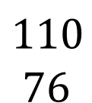
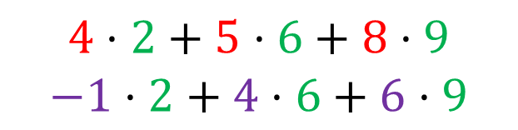
Brief Matrix Multiplication Example
4 5 8
-1 4 6
B = 2
6
9
A =
A x B:
2 x 3 3 x 1 → 2 x 1
*
4 5 8
-1 4 6
2
6
9
$$4⋅2+5⋅6+8⋅9$$
$$−1⋅2+4⋅6+6⋅9$$
=
$$110$$
$$76$$
=

